Slide 1
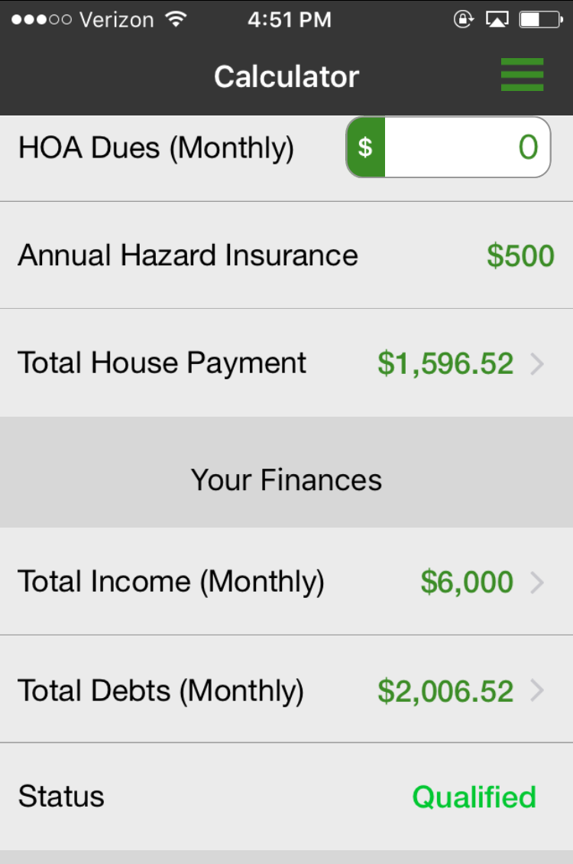
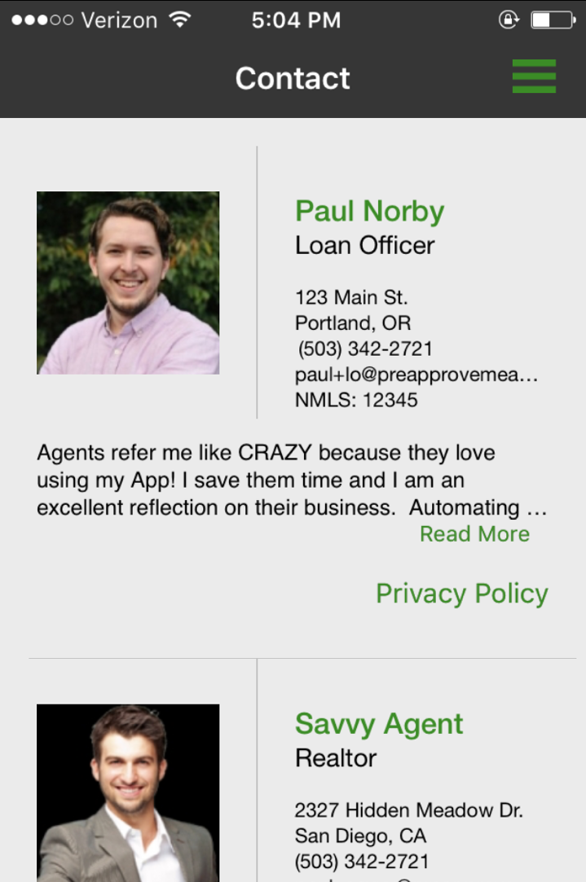
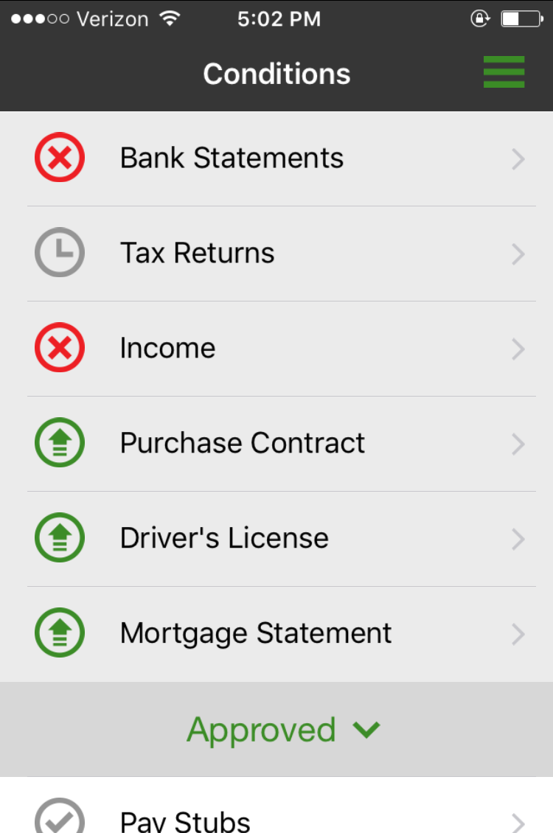
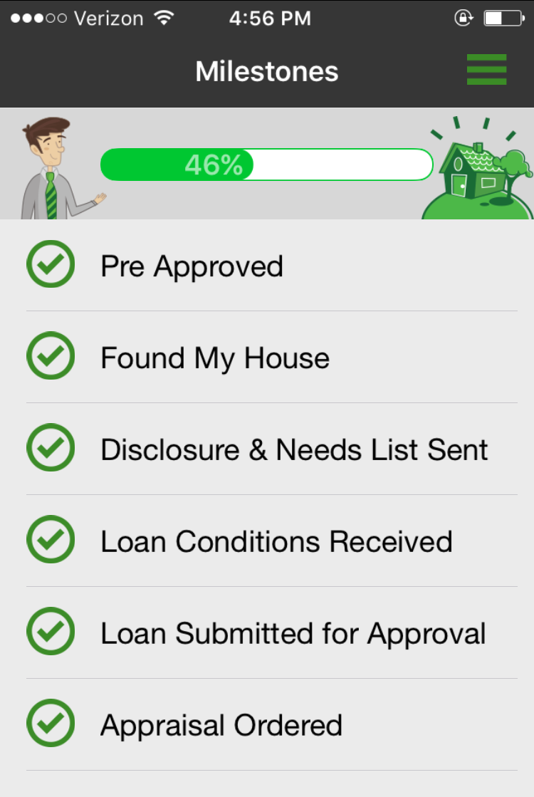

myMobileLO
Empowering our referral partners and borrowers

Slide 2
We are using the Power of Mobile Technology to...
Save You Time
Improve Communication
Ensure Closure
Delight Clients

Slide 3
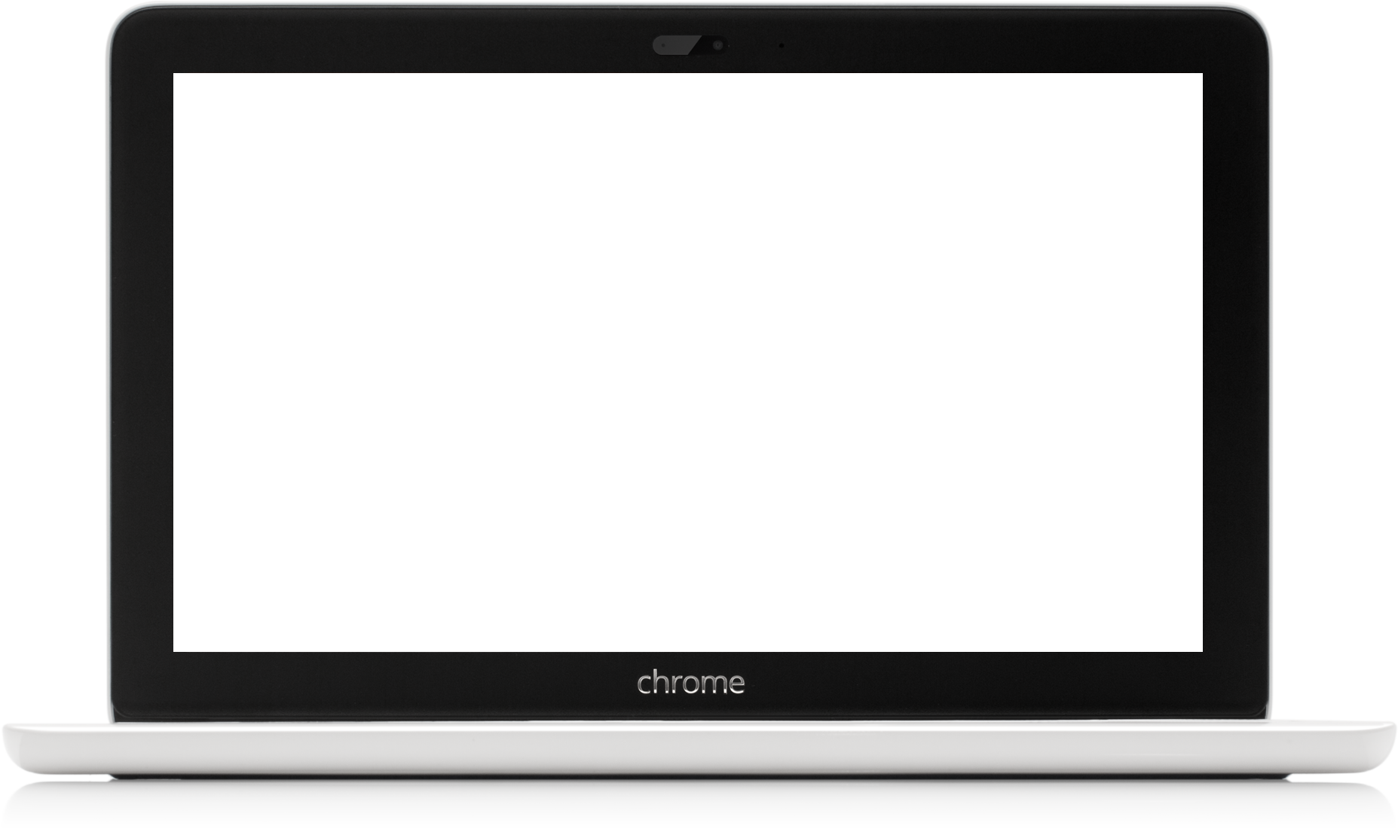
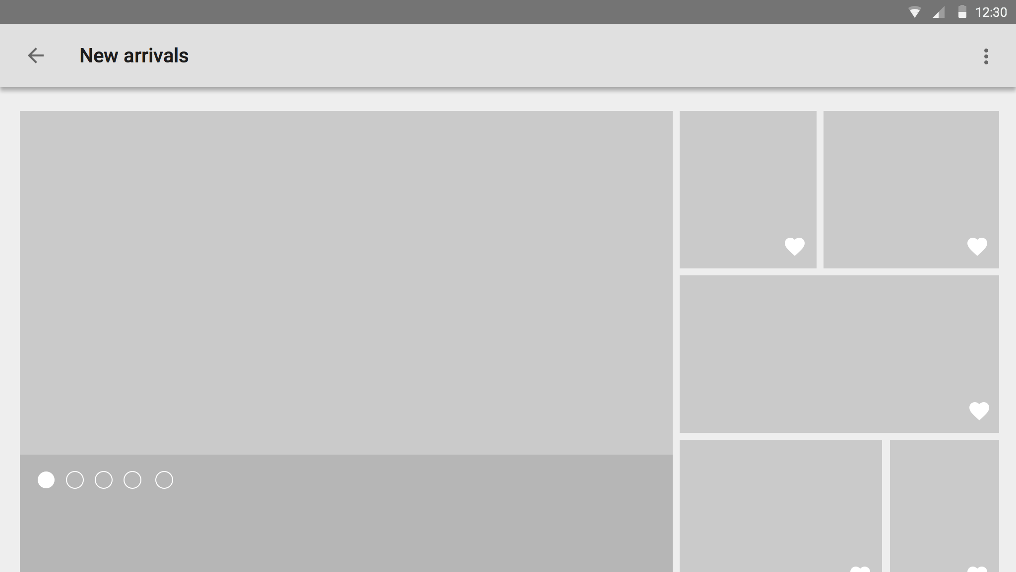
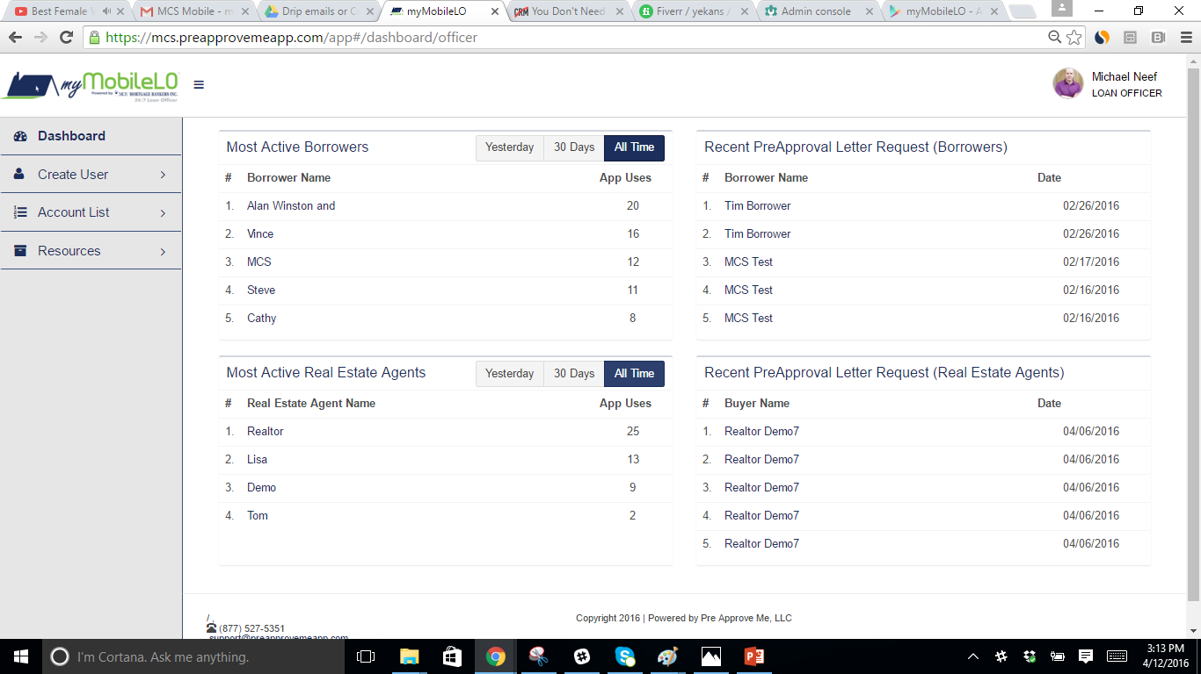
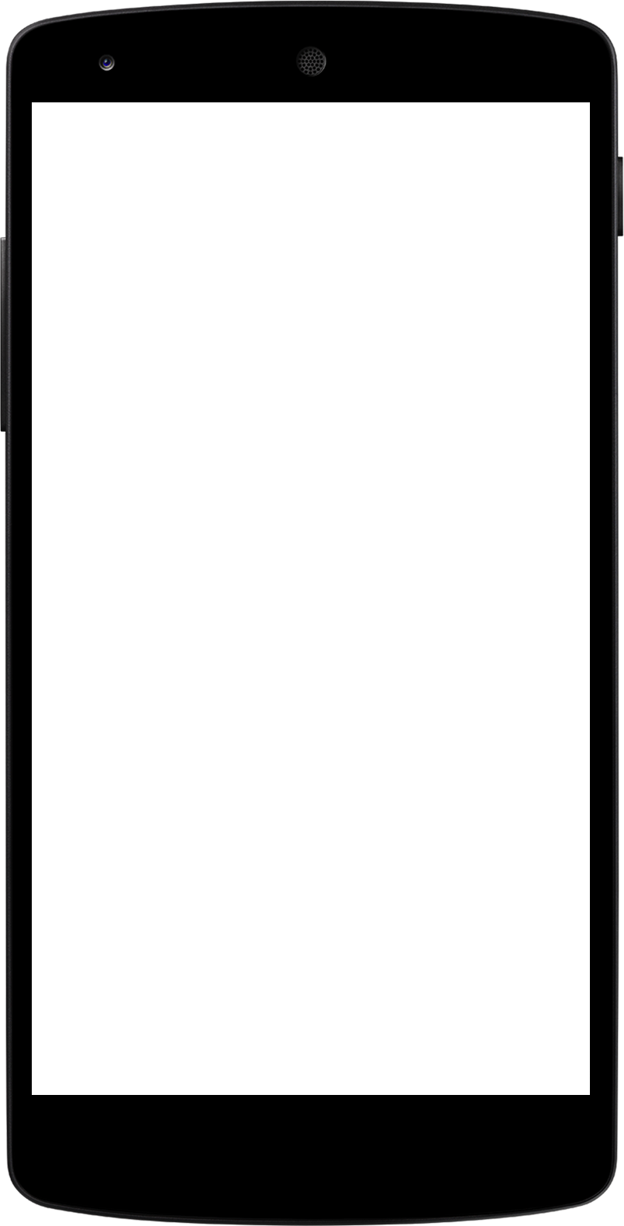
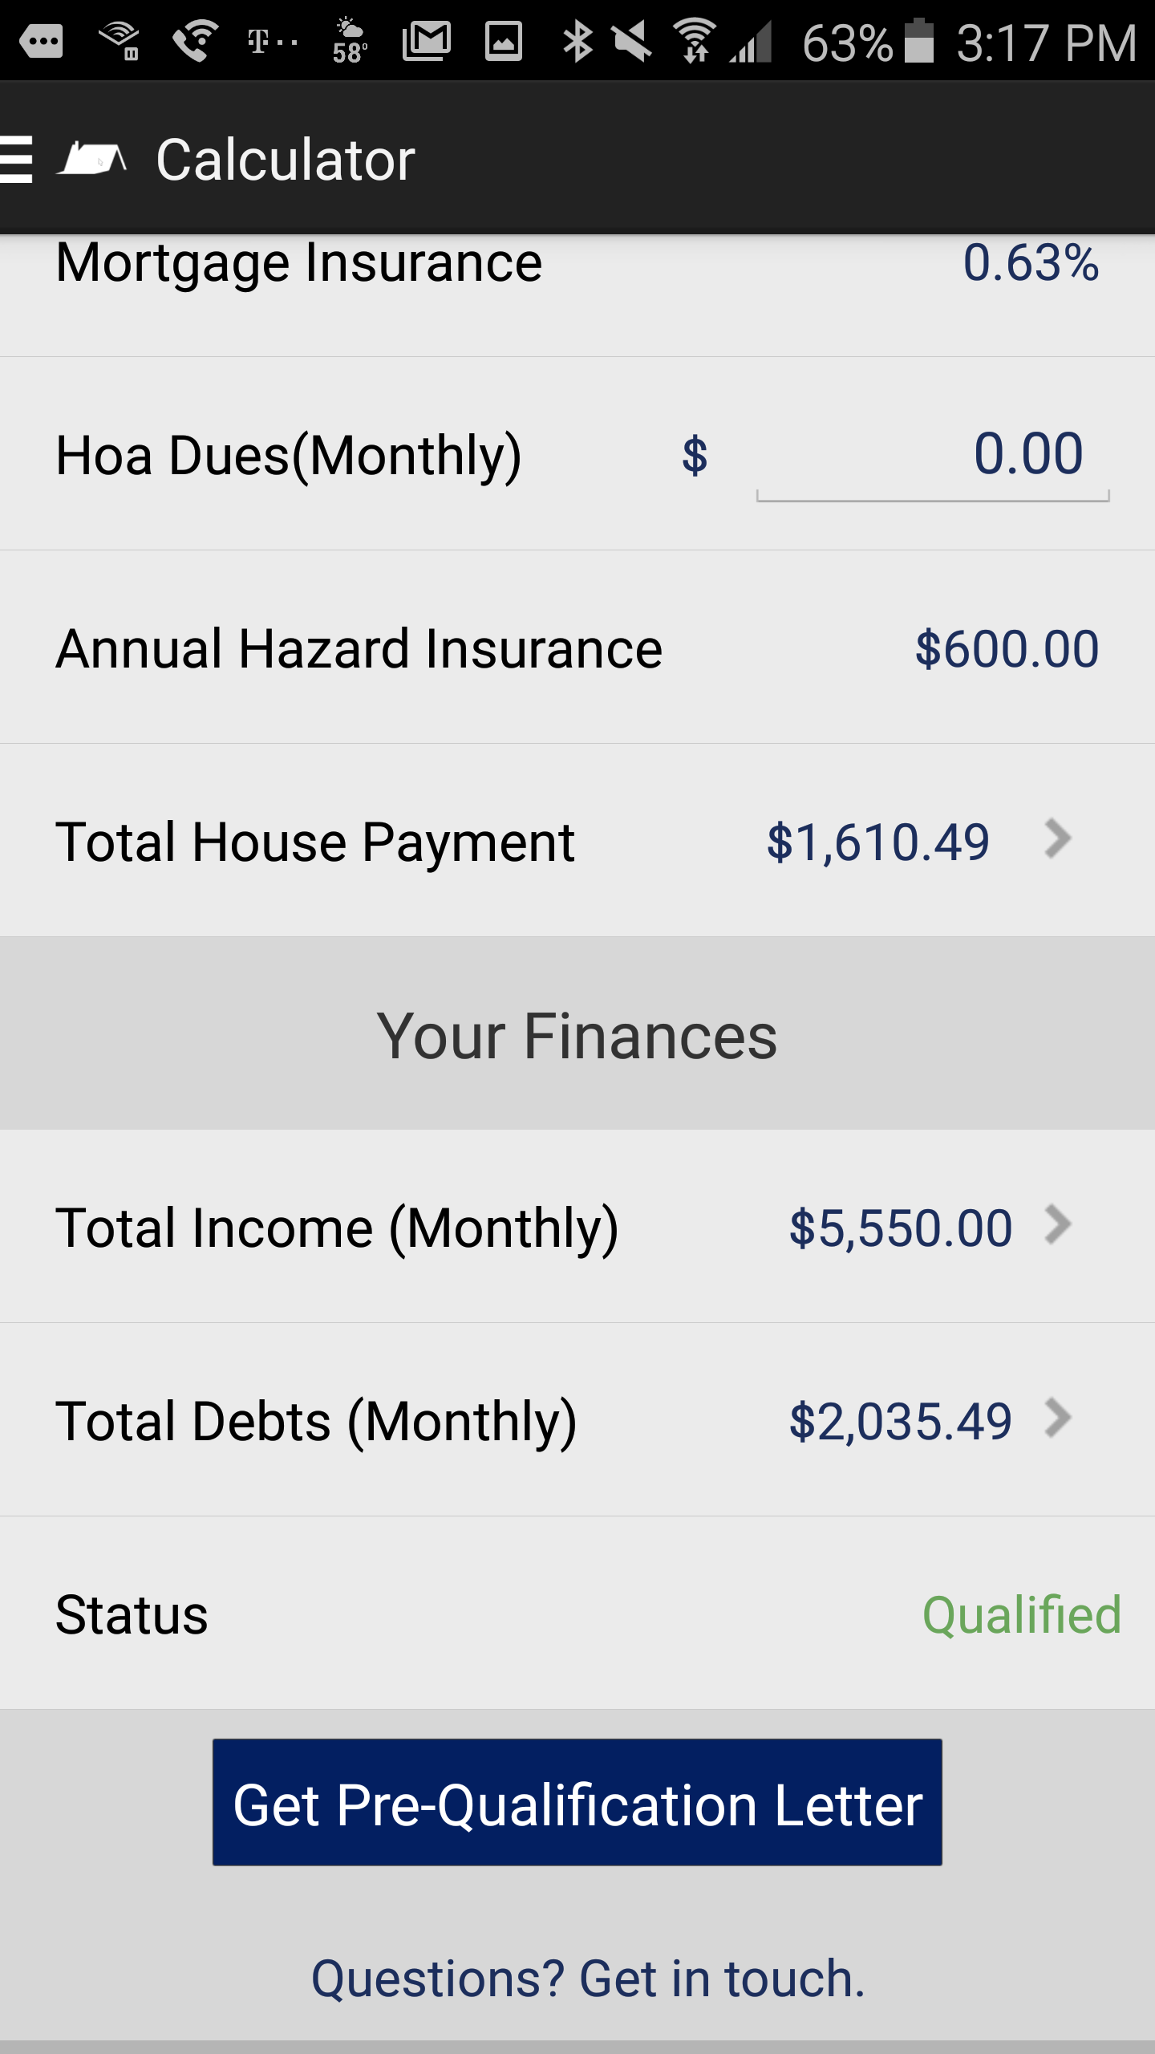
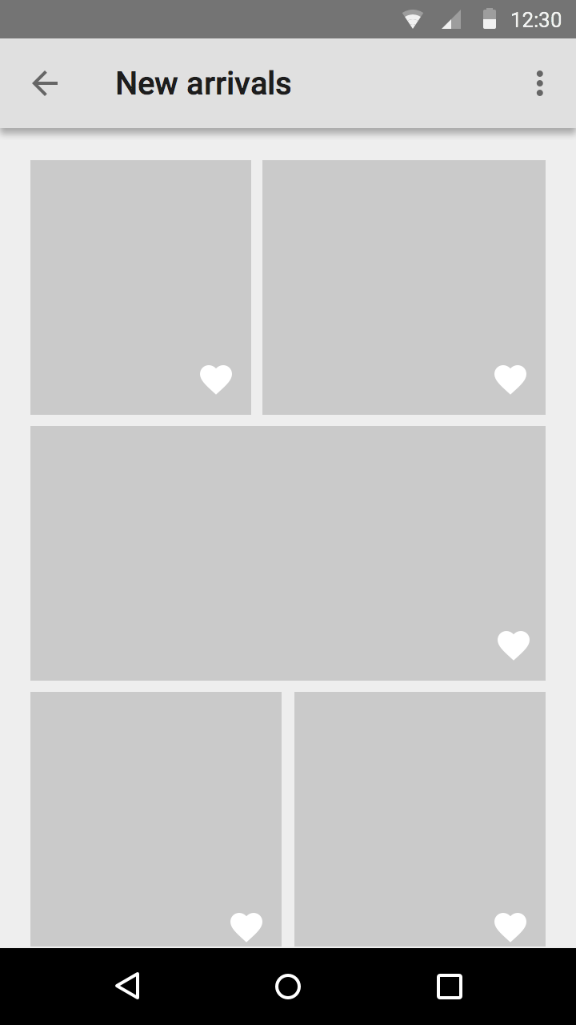
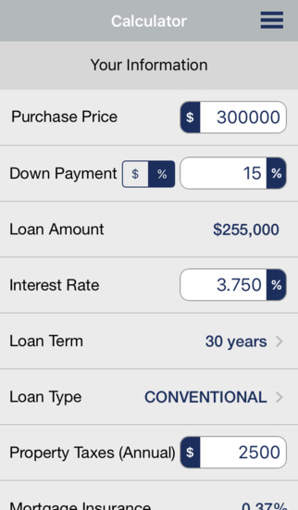
Protecting your Time
You or your buyer can update the home’s qualifying criteria and have an accurate, custom pre-approval letter emailed to you in seconds.
Just type in the price, down payment, taxes, insurance, and hoa dues and you will KNOW before you ever show a property if your client can qualify to buy it.

Slide 4
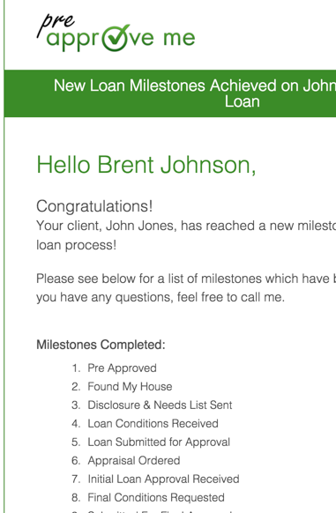

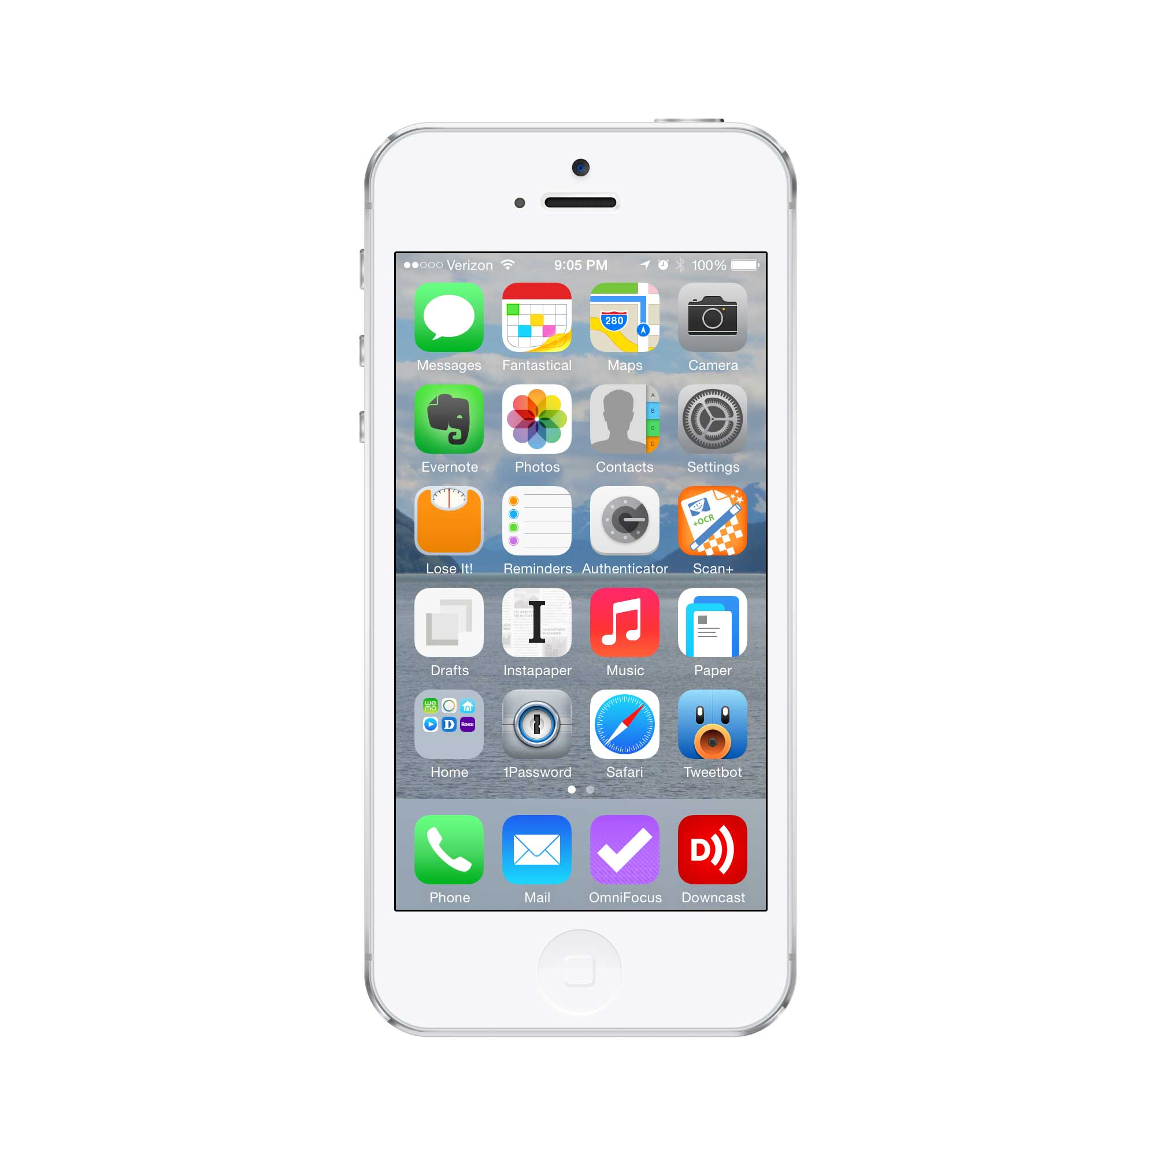
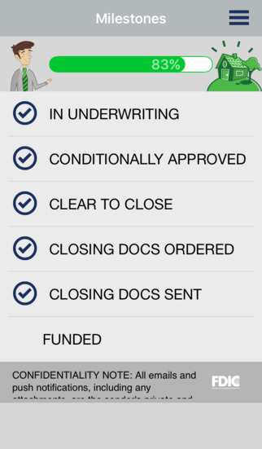
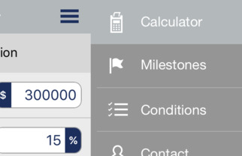
Seamless Communication
1. You will receive push notifications and emails whenever a new milestone is reach in the loan process for your buyer.
2. You have access to a real time “thermometer” at any time by touching the milestones tab in your selected buyer’s profile
Quick Tip: All of the tabs you need are accessed using the “hamburger” button located at the top of the screen.

Slide 5
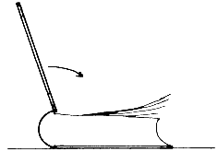
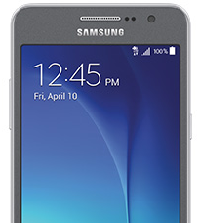
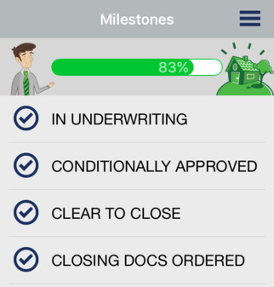
WE ALL NEED CLOSURE
One of the most frequent reasons that loans do not close on-time today is missing or late conditions.
You now have full access 24/7 to see which of your buyer’s conditions have been accepted, rejected or are pending review. You will never be left out in the dark again when it comes to the welfare of your client!

Slide 6
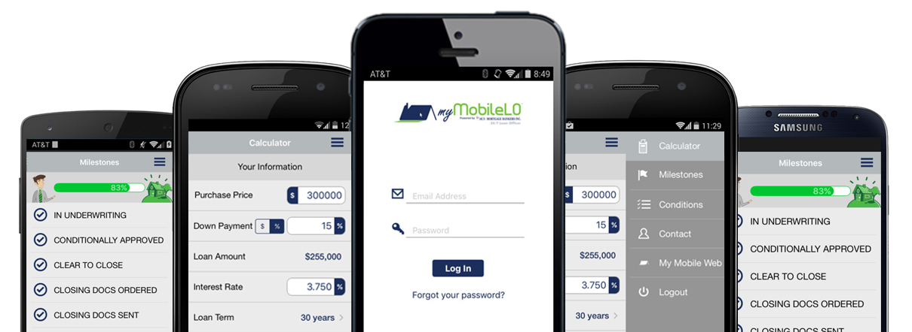
Let me Know if you would like to download my app today!

